Slide 1
Multiple Sequence Alignment
Analysis Module

Slide 2
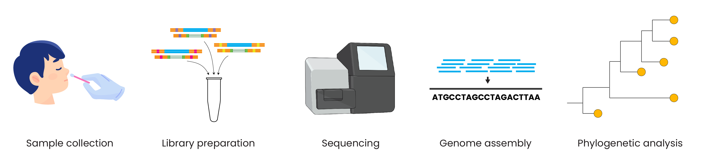
Genomic epidemiology workflow
BioRender.com
Pixel True https://www.pixeltrue.com/about, CC BY-SA 4.0, via Wikimedia Commons
Notes:
Feedback:
- I’ll provide an overview figure to add here!

Slide 3
Genomic epidemiology workflow
1
Build a background dataset
Multiple sequence alignment
Run phylogenetic analysis
2
3
BioRender.com
Pixel True https://www.pixeltrue.com/about, CC BY-SA 4.0, via Wikimedia Commons

Slide 4
Genomic epidemiology workflow
1
Build a background dataset
Multiple sequence alignment
Run phylogenetic analysis
2
3
BioRender.com
Pixel True https://www.pixeltrue.com/about, CC BY-SA 4.0, via Wikimedia Commons

Slide 5
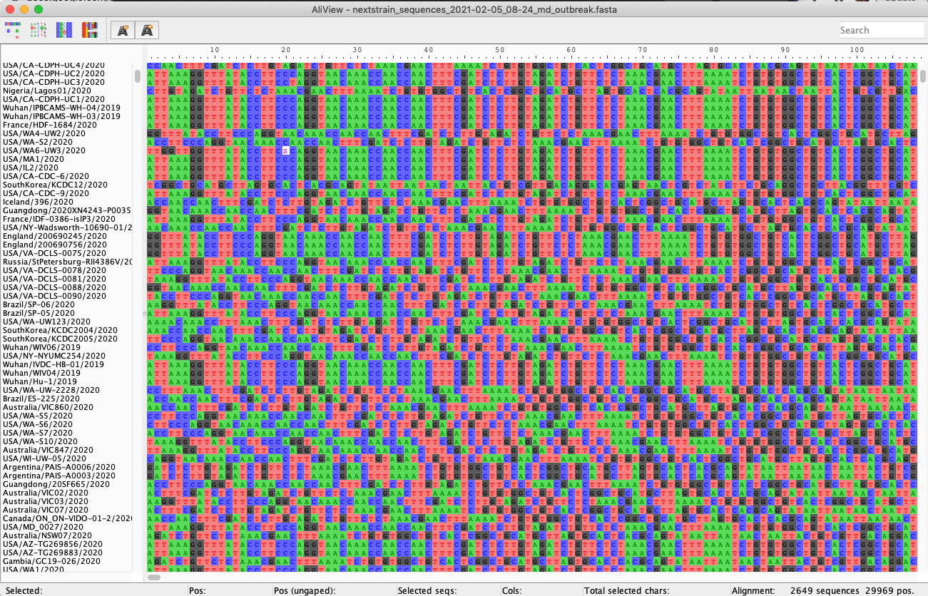
Multiple sequence alignment

Slide 6
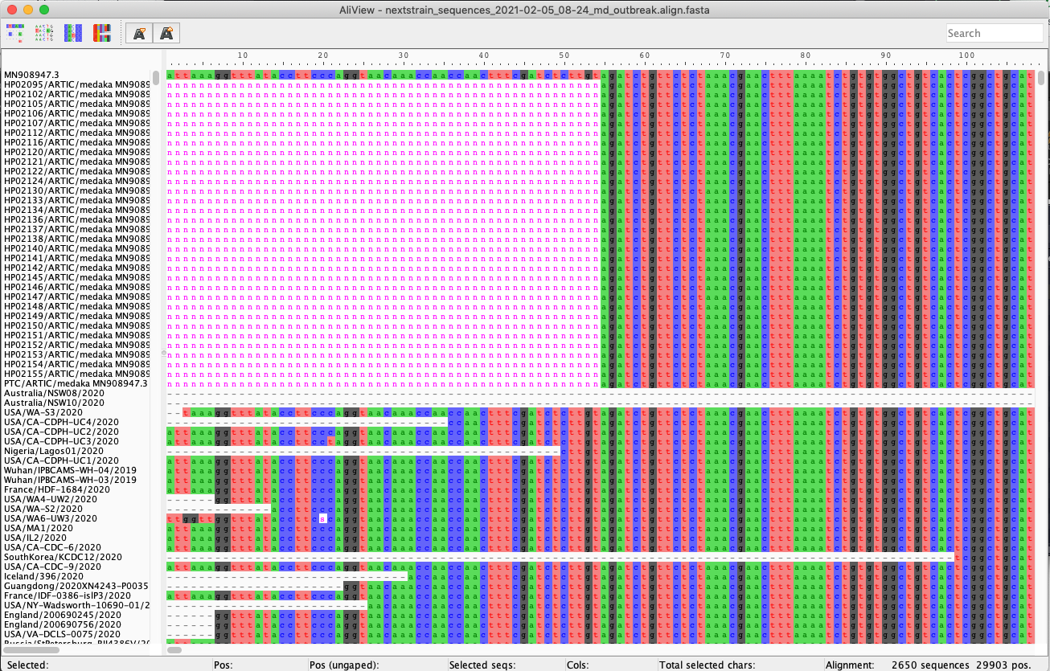
Multiple sequence alignment

Slide 7


Types of multiple sequence alignment
Alignment with a reference genome
Alignment without a reference genome

Slide 8
Types of multiple sequence alignment
Alignment with a reference genome
Faster and less computationally intensive
Ensures consistent coordinates
Alignment without a reference genome

Slide 9
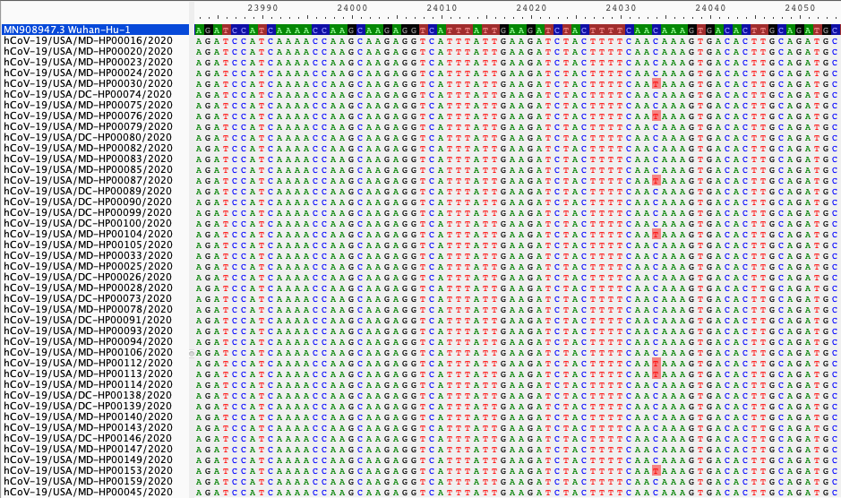
Alignment with a reference genome
Position along reference genome
Reference
genome
Your assembled FASTA files, aligned to the reference
Single nucleotide variants, compared to reference
Aligning to a reference genome gives us a baseline to call variants against

Slide 10
Selecting an appropriate reference genome
Ways to choose a reference genome:
If possible, use the same reference genome as others working on the same outbreak
e.g., Wuhan-Hu-1 for SARS-CoV-2
e.g., Makona-Kissidougou-C15 for Ebola virus
Use the earliest sequence from the outbreak, if available
Use a sequence from a prior outbreak in the same location
Search NCBI RefSeq (https://www.ncbi.nlm.nih.gov/refseq/) for an established reference
The reference genome should always have a date before the earliest of your samples

Slide 11
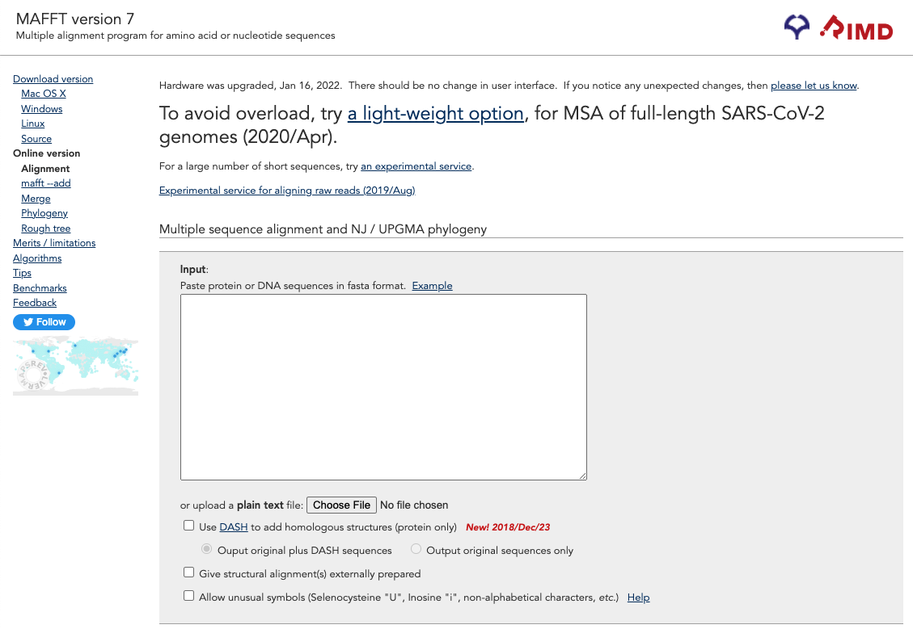

Slide 12
https://mafft.cbrc.jp/alignment/server/

Slide 13
https://mafft.cbrc.jp/alignment/server/

Slide 14
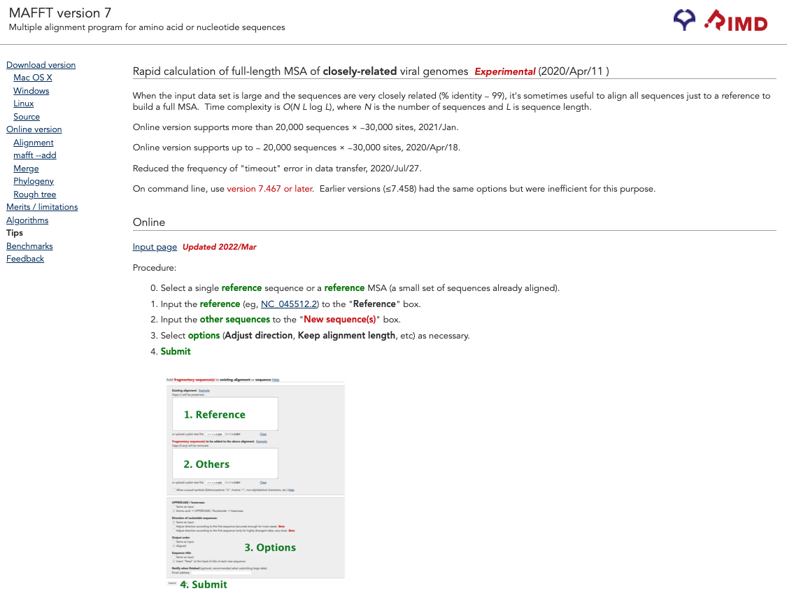

Slide 15
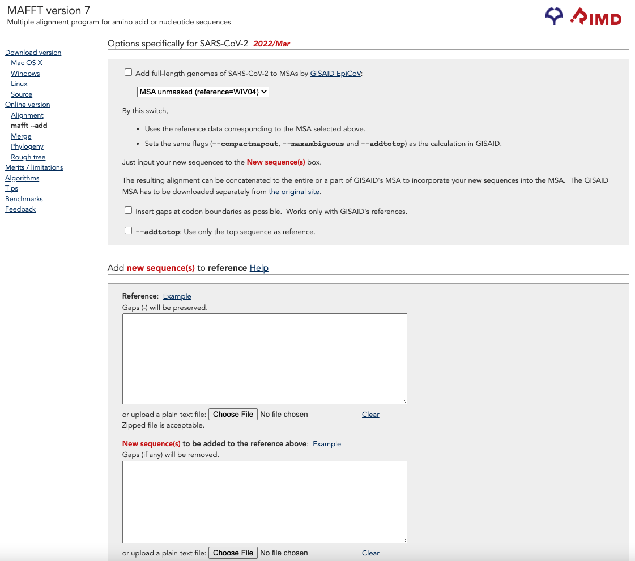

Slide 16
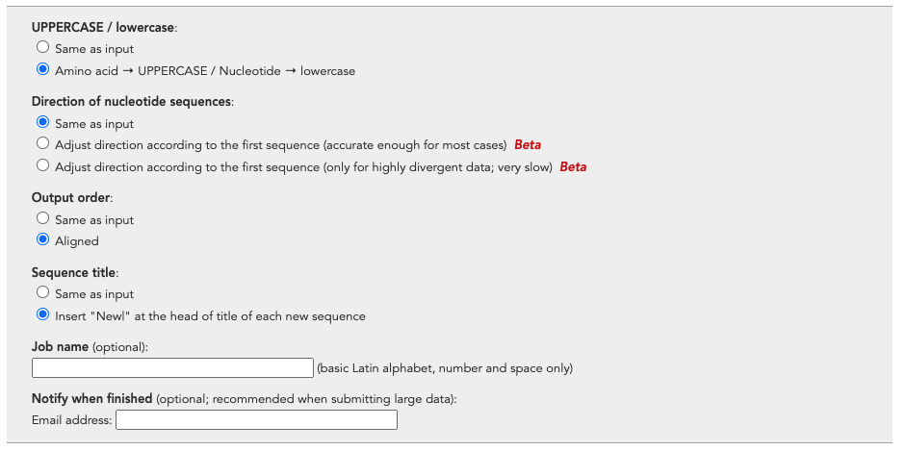

Slide 17
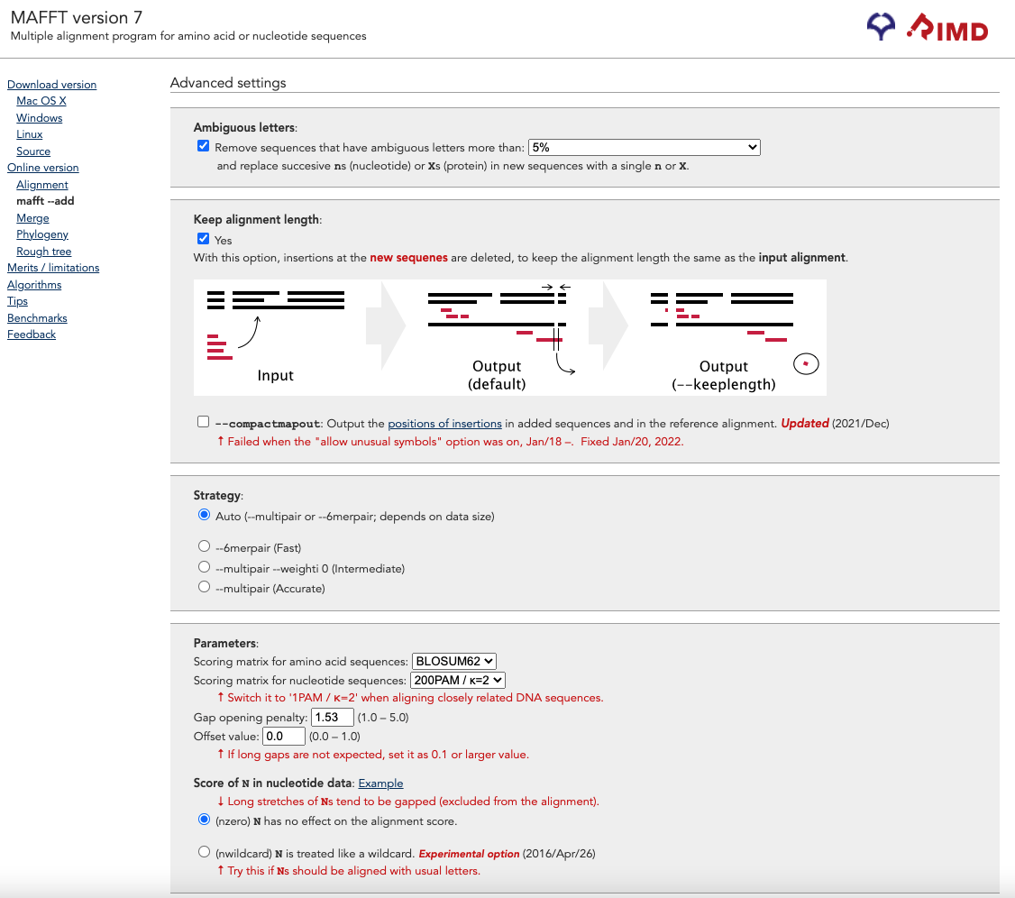

Slide 18
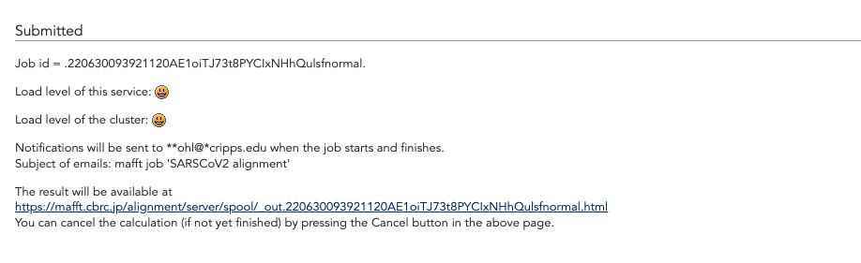

Slide 19
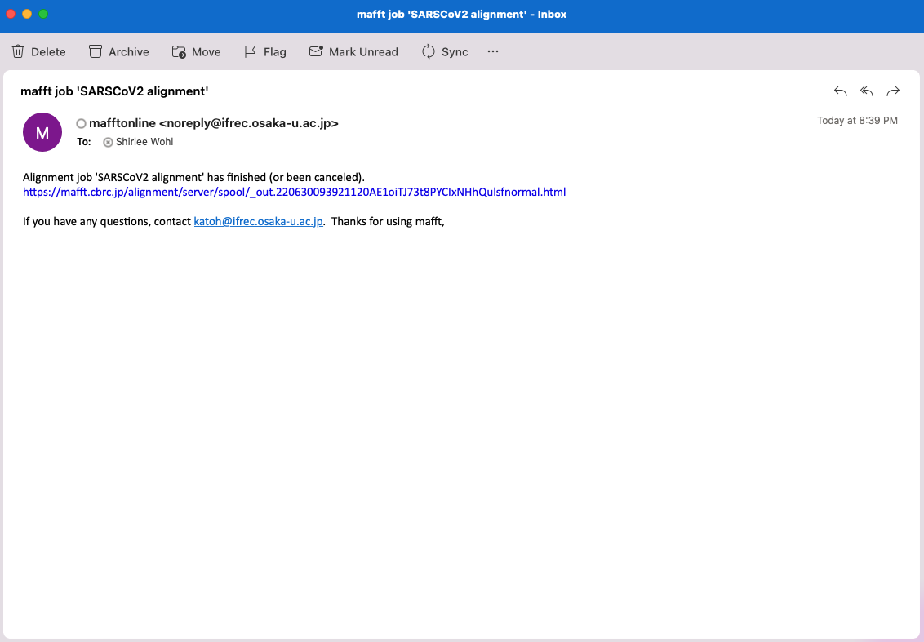

Slide 20
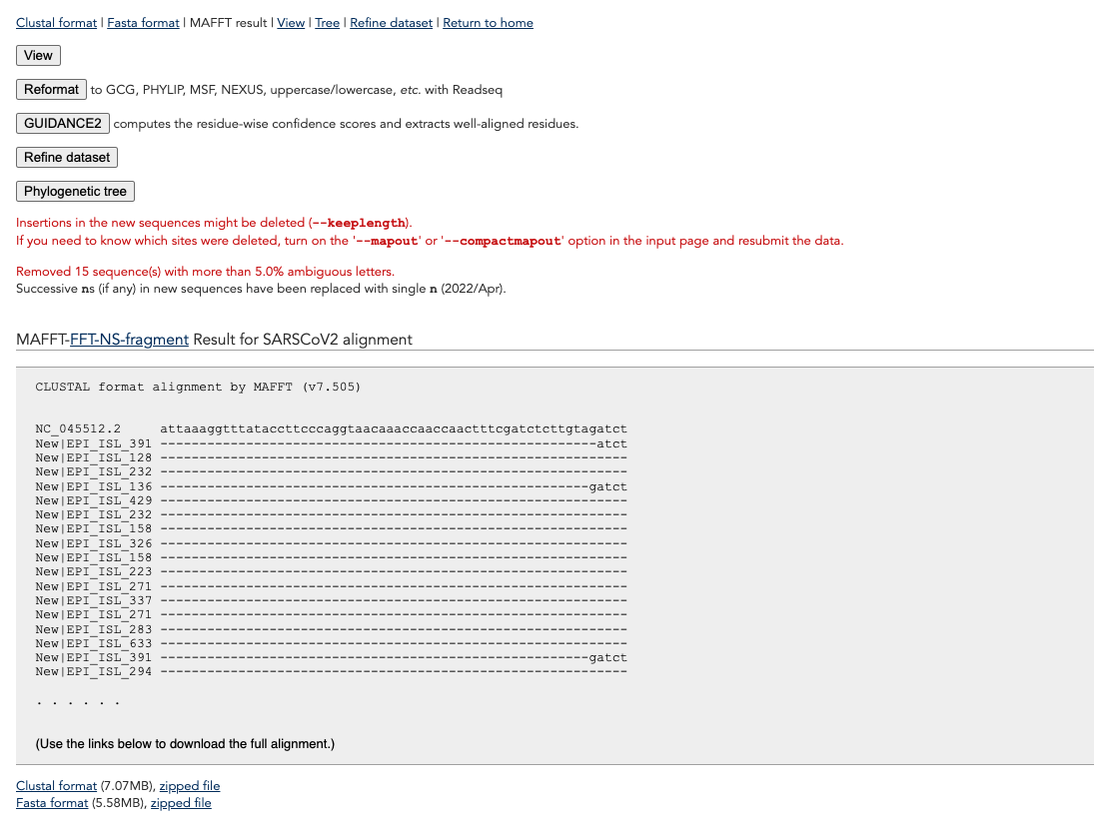

Slide 21
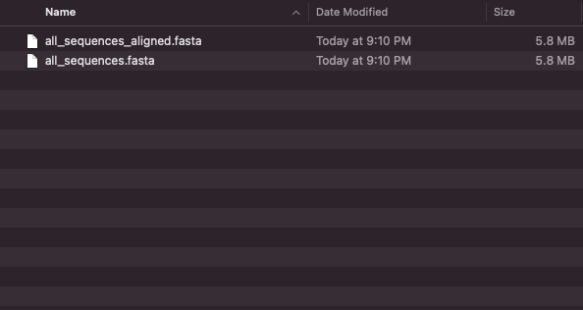

Slide 22
Outline
Types of multiple sequence alignments
Multiple sequence alignment with MAFFT
Inspecting and editing alignments

Slide 23
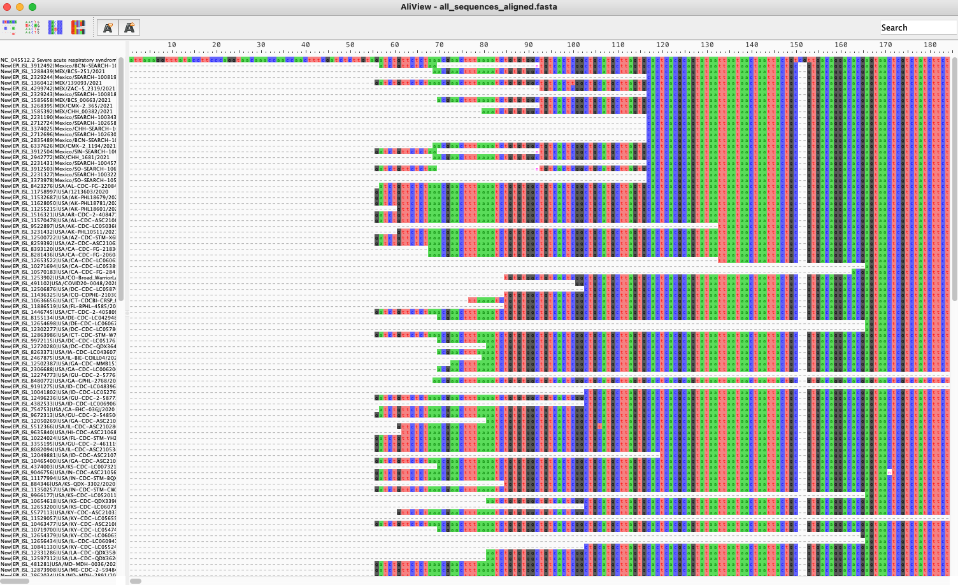
https://ormbunkar.se/aliview/

Slide 24
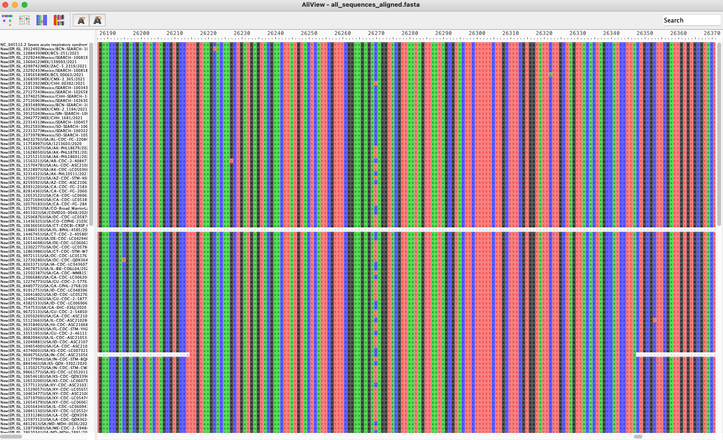

Slide 27
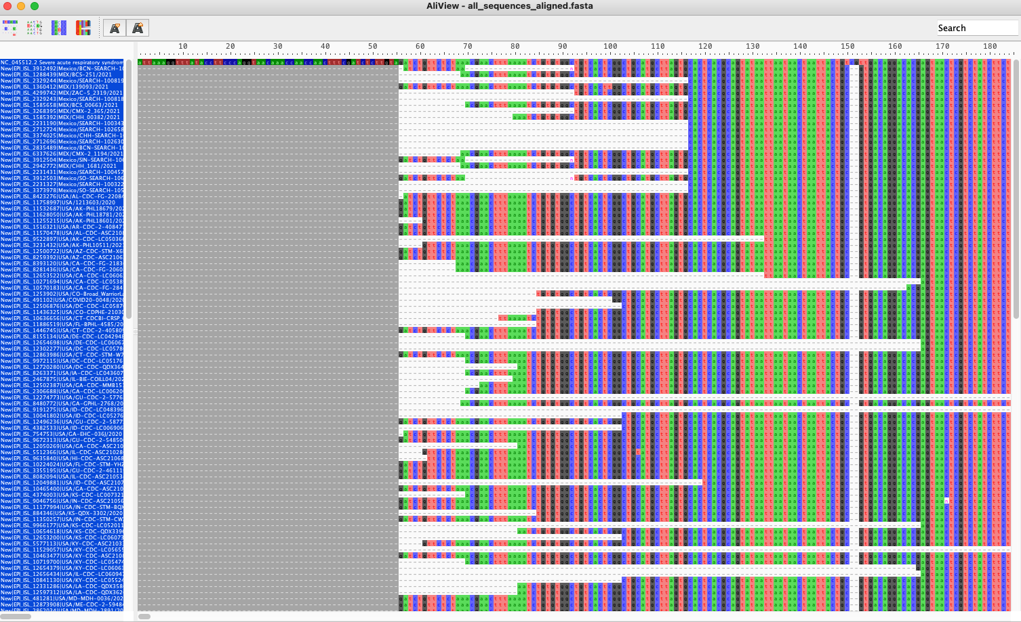

Slide 28
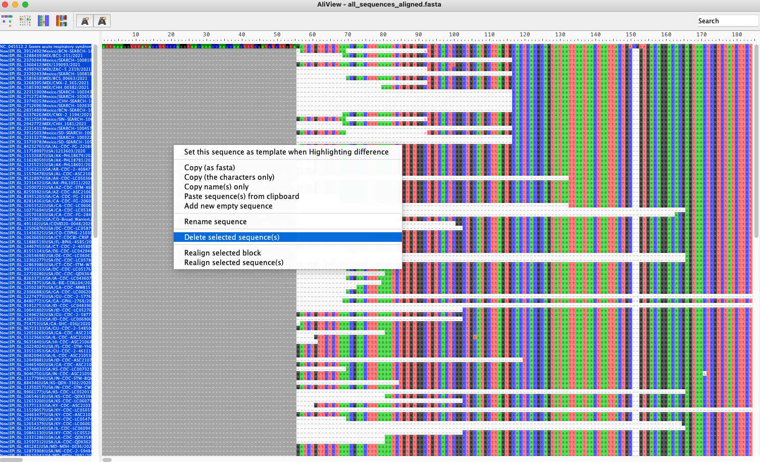

Slide 29
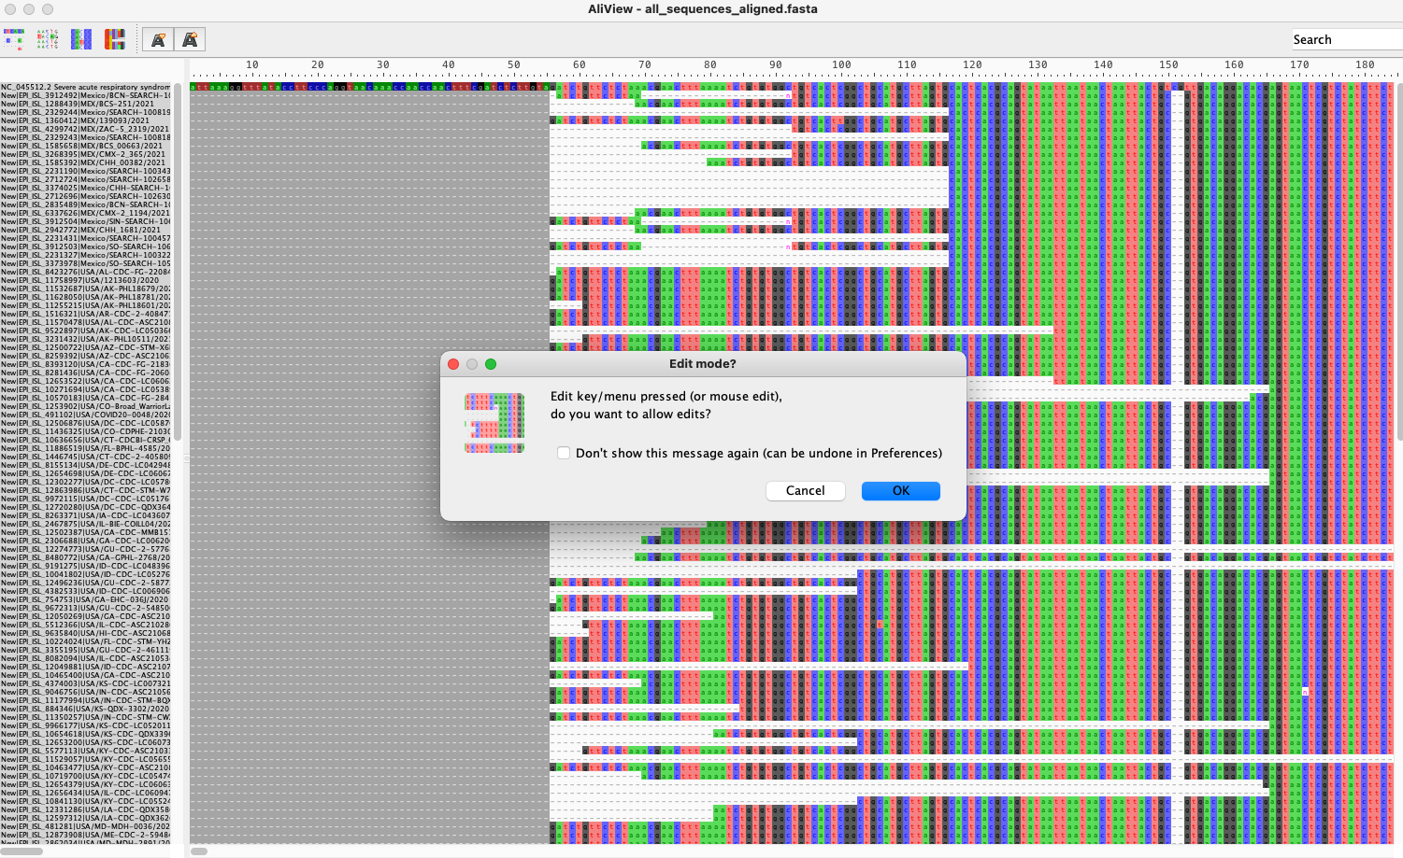

Slide 30
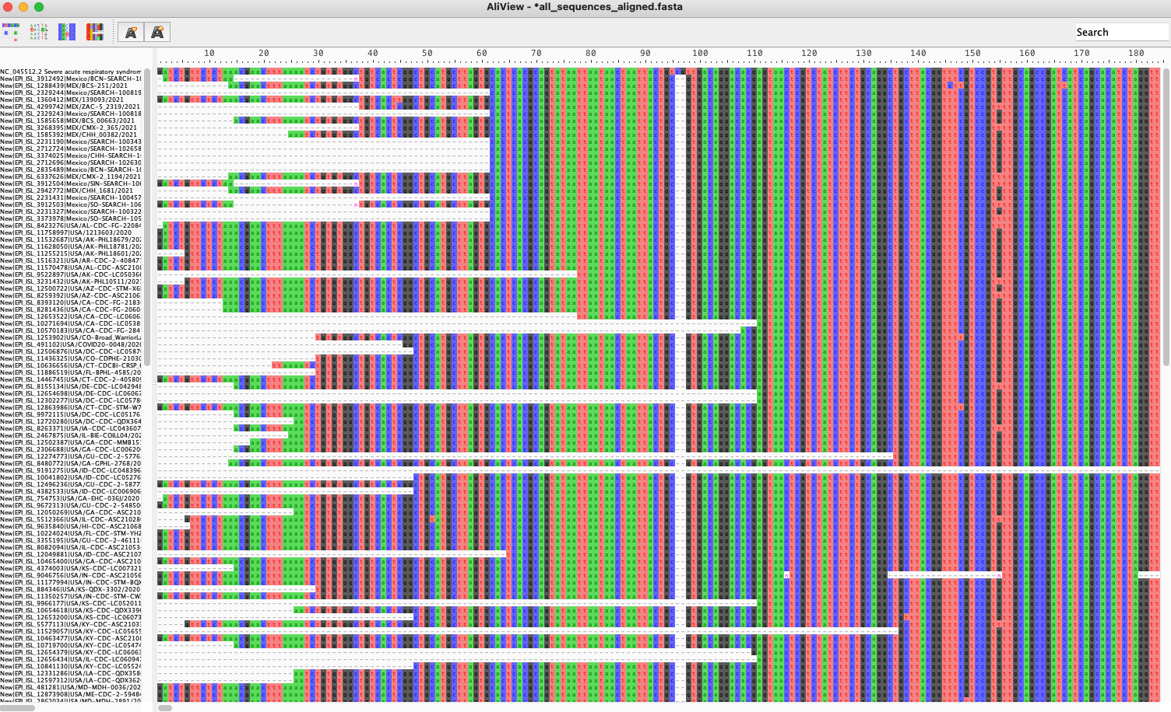

Slide 31
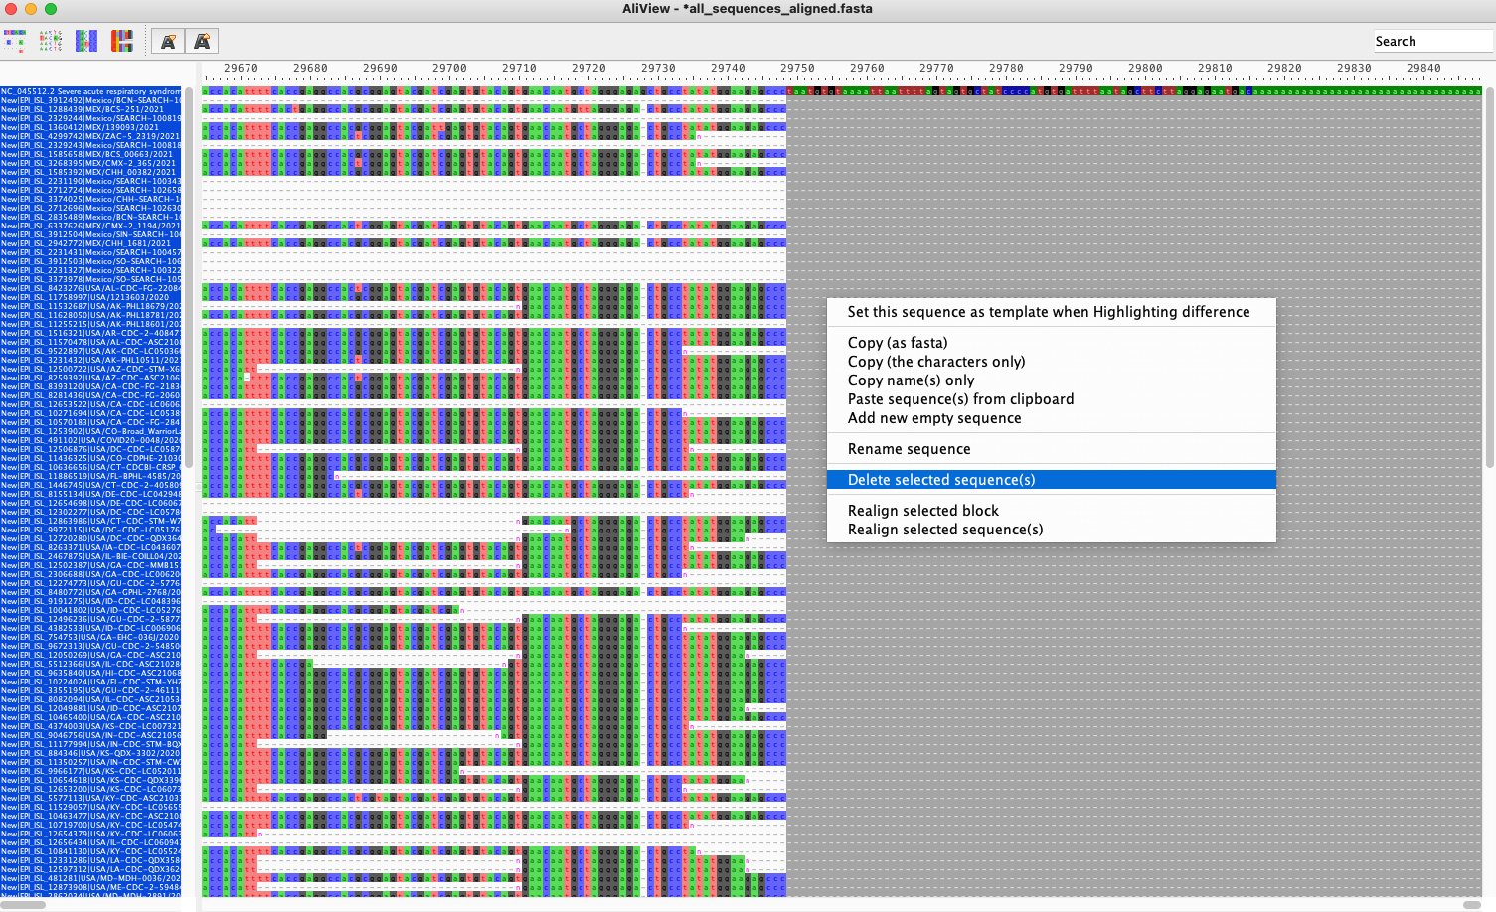

Slide 32
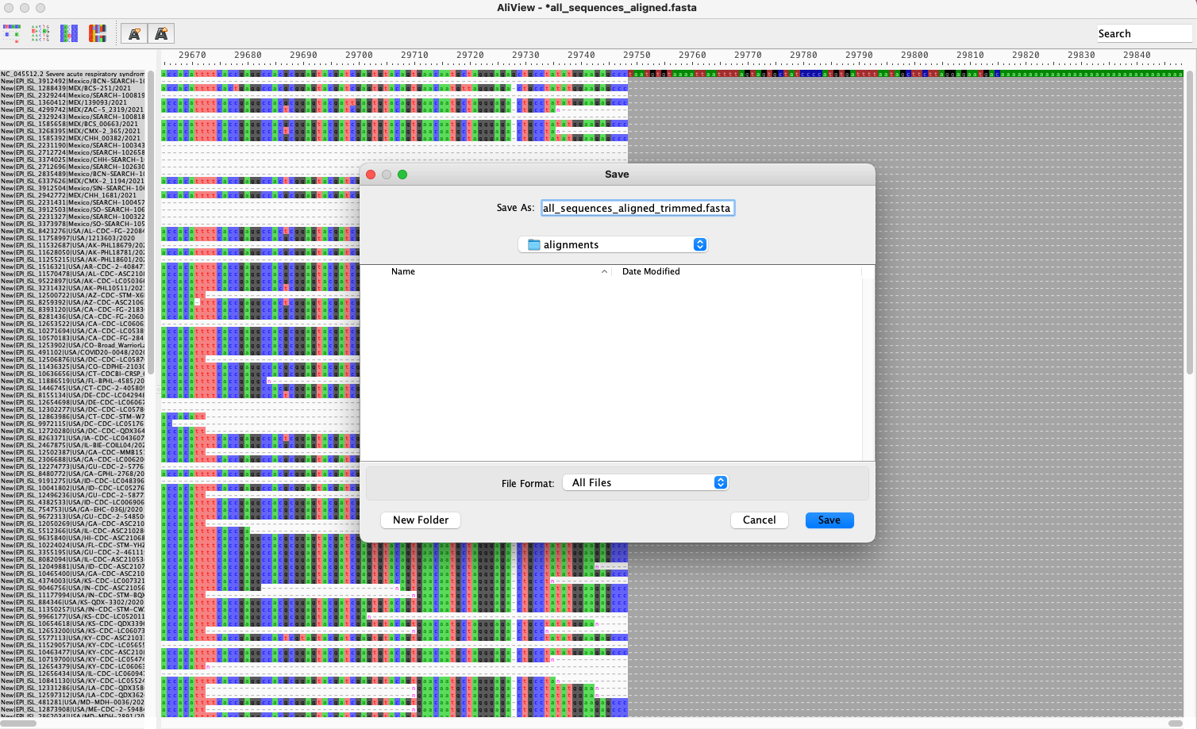

Slide 33
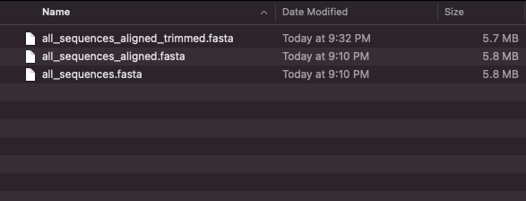
Use trimmed file for phylogenetics, but untrimmed alignment for variant analysis

Slide 34
Genomic epidemiology workflow
1
Build a background dataset
Multiple sequence alignment
Run phylogenetic analysis
2
3
BioRender.com
Pixel True https://www.pixeltrue.com/about, CC BY-SA 4.0, via Wikimedia Commons

Slide 35
Summary
Multiple sequence alignment is required prior to phylogenetic analysis
Alignment with a reference genome is faster and often preferred over reference-free alignment
MAFFT is a common tool for multiple sequence alignment of viral genomes
Always inspect your alignment to ensure quality

